Slide 1
French Class Leçon 2

Slide 2
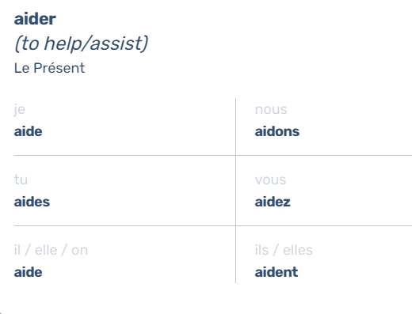
ER Verbs

Slide 3
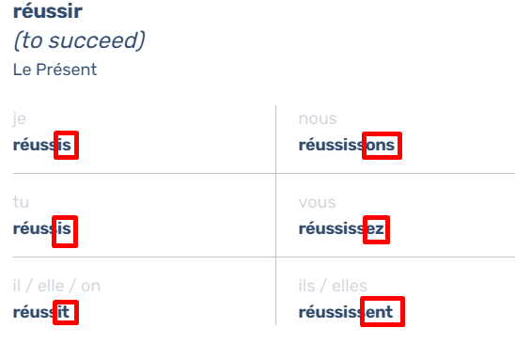
IR Verbs

Slide 4
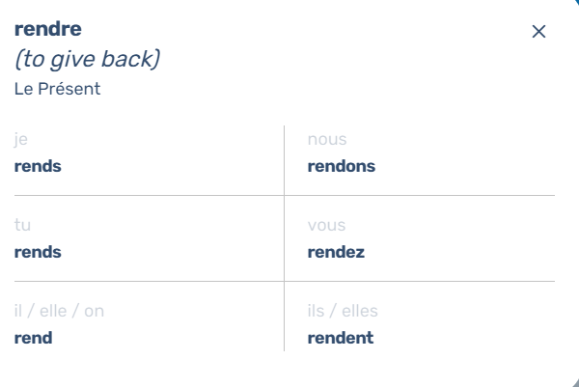
RE Verbs

Slide 5
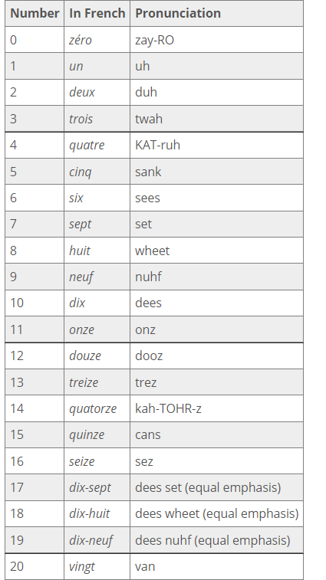
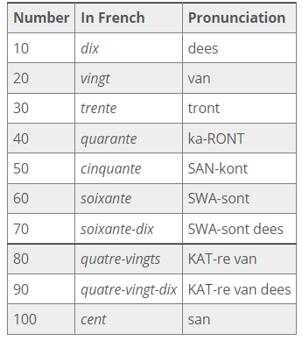
Numbers (1-20)
https://study.com/academy/lesson/how-to-count-to-100-in-french.html

Slide 6

Les Couleurs
un chien blanc
une carte blanche
https://i.etsystatic.com/5913426/r/il/66f895/261238935/il_570xN.261238935.jpg

